Slide 1
Dynamics of Chromosome Movements During Meiosis in Fission Yeast
--- Simulation using bead-rod model
Wenwen Huang
19.05.2014

Slide 2
Outline
Biological background
Bead-rod model
(dynamical equations, numerical scheme, parameters)
Simulation Result
(animation movie, compare with theory)
Summary and Discussion

Slide 3
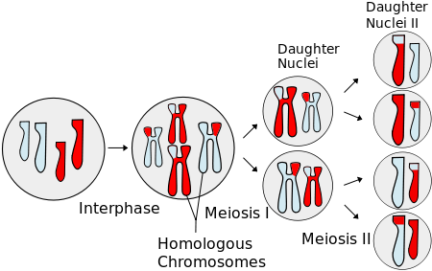
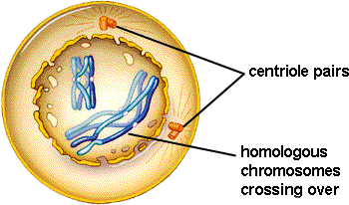
Meiosis
Prophase I
Chromosome movements
Pairing
Recombination

Slide 4
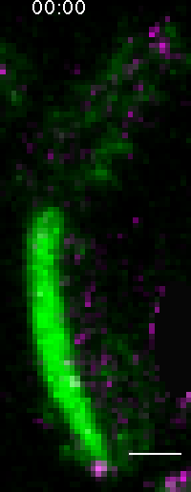
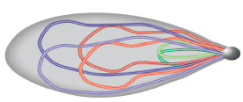
Nuclear Oscillation (Schizosaccharomyces pombe)
3 pairs of chromosomes
Telomere bond to SPB
Oscillation is driven by SPB
In the mean time:
Homologous chromosomes
paring and recombination
What is the exact role of nuclear oscillation?
Chikashige et al., Science 1994
Yamamoto et al, JCB 1999
Ding et al., DevCell 2004

Slide 5
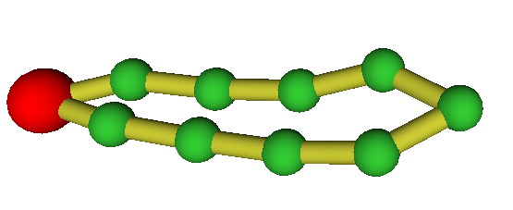
Bead-Rod Ring Model
A Chromosome is represented by a bead-rod ring with
the driven bead be the SPB(spindle pole body).
Ring driven by a periodic force
Bead:
position ----
Rod:
length ---

Slide 6
Brownian Dynamics:
Inertia-less assumption
is the index of bead
is hydrodynamic force
represents force generate from potential
is constraint force to keep the rod length
is brownian force
is external force

Slide 7
Brownian Dynamics:
Dynamical differential equation:

Slide 8
Numerical Scheme
Predictor-corrector algorithm:
Step 1: predict using known forces
Step 2: correct using constraint force
(*)
Step 3: substitute eq. (*) to constraint equations
Solve a set of nonlinear algebraic equations
Step 4: re-substitute to (*) obtain the final

Slide 9
Parameter Estimation
Length of Chromosomes in base pairs:
There are 3 pairs of chromosomes in prophase fission yeast
Chromosome I: 5.579.133 bp ~ 5,6Mbp
Chromosome II: 4.539.804 bp ~ 4,5Mbp
Chromosome III: 2.452.833 bp ~ 2,5Mbp
Compaction ratio of chromosomes: ~ 100bp/nm
Kuhn length(rod length): ~ 100nm
System size for 3 pairs of chromosomes: ~ 2000-3000
monomers in one ring : 200 ~ 600

Slide 10
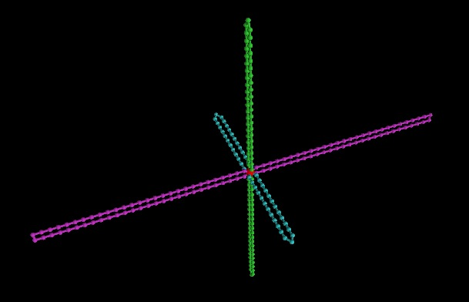
Initial configuration

Slide 11
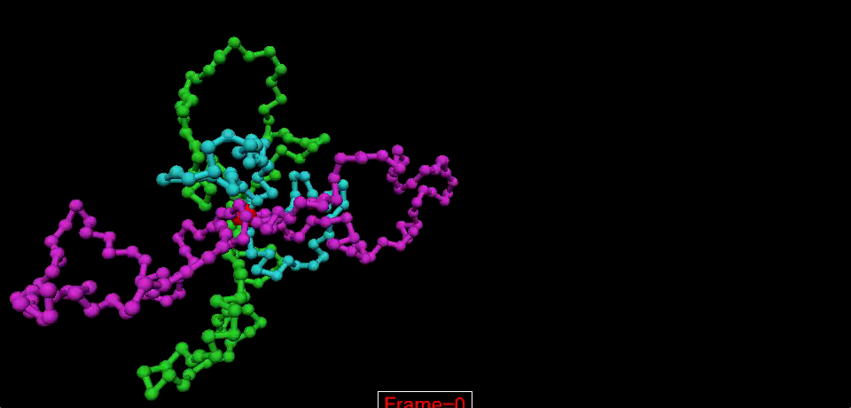
Animation Movie

Slide 12
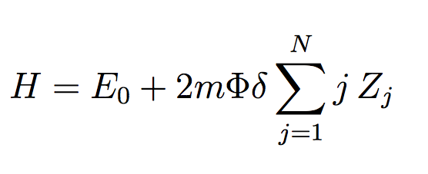
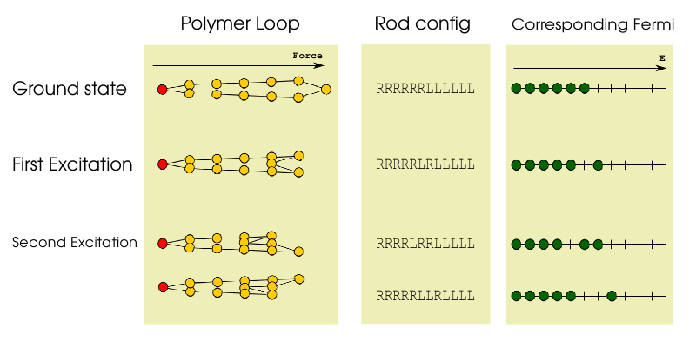
Theoretical Stories (Yen Ting Lin)
The Hamiltonian of the system:
Equivalent to N/2 Fermions in N energy levels

Slide 13
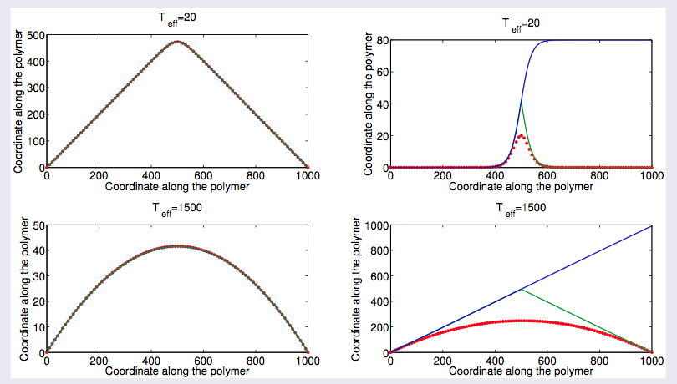
Theoretical Stories (Yen Ting Lin)

Slide 14
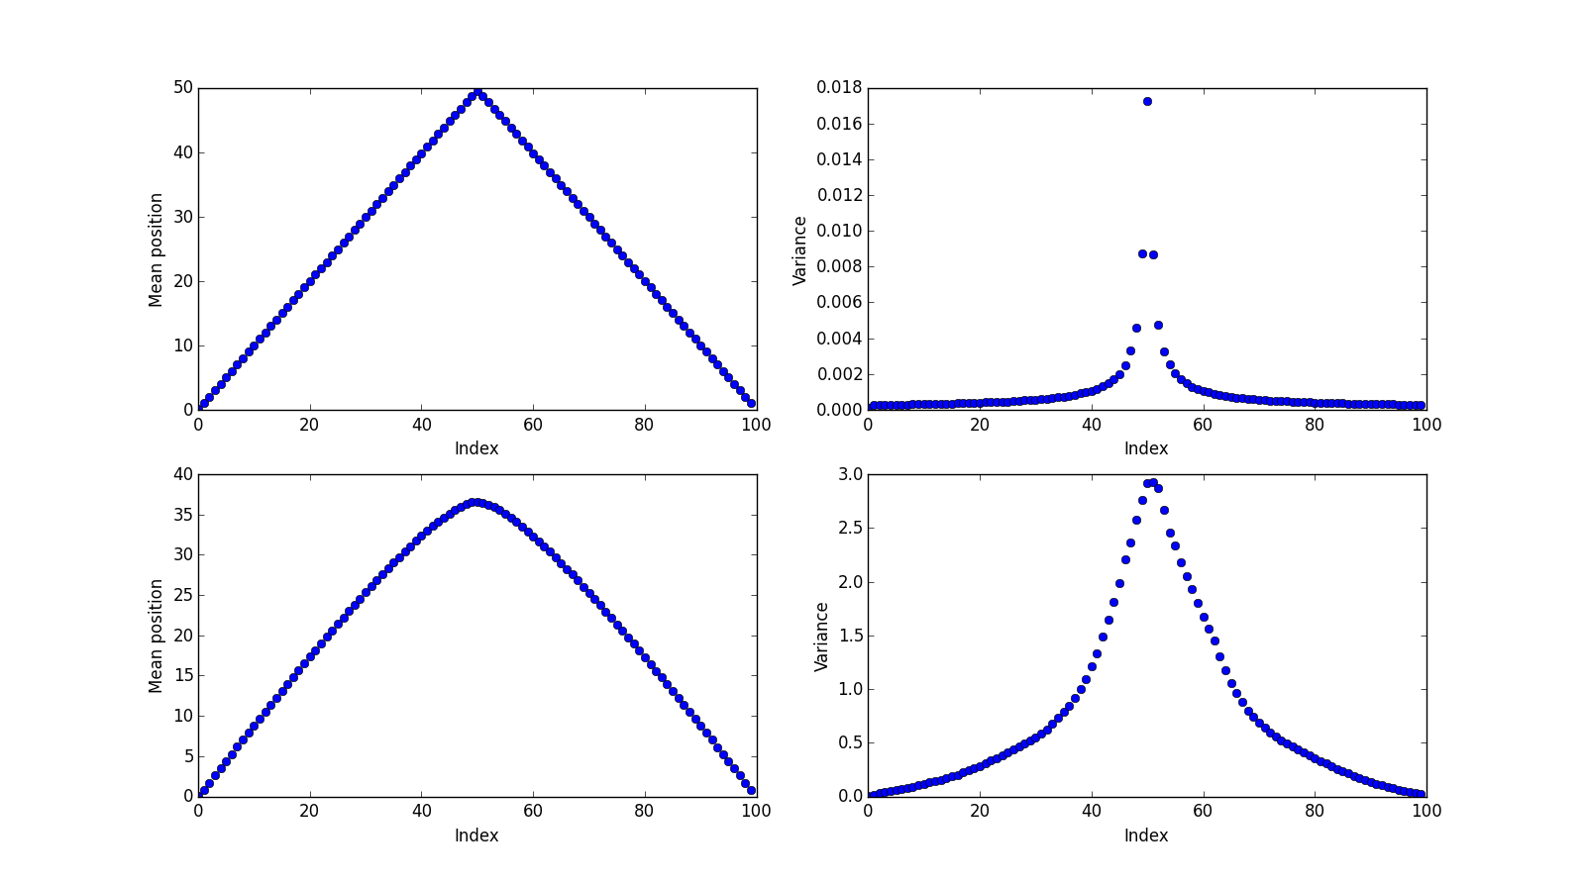
Numerical comparison
With Lennard-Jones potential

Slide 15
Summary
We set up a bead-rod polymer model to simulate the chromosome movements during prophase of meiosis I in fission yeast.
The statistics of a bead-rod ring in a force field is equivalent to Fermi statistics.

Slide 16
All suggestions and comments
are greatly appreciated!
Thank you!

Slide 17
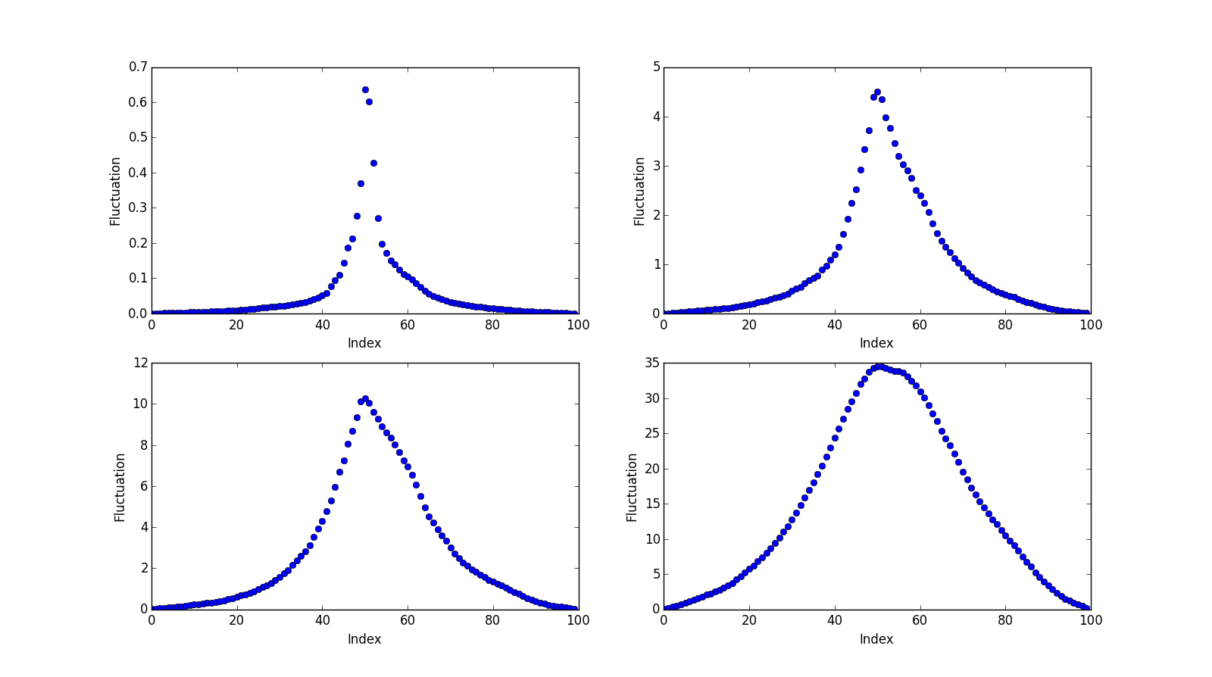
Numerical comparison
Without Lennard-Jones potential

Slide 18
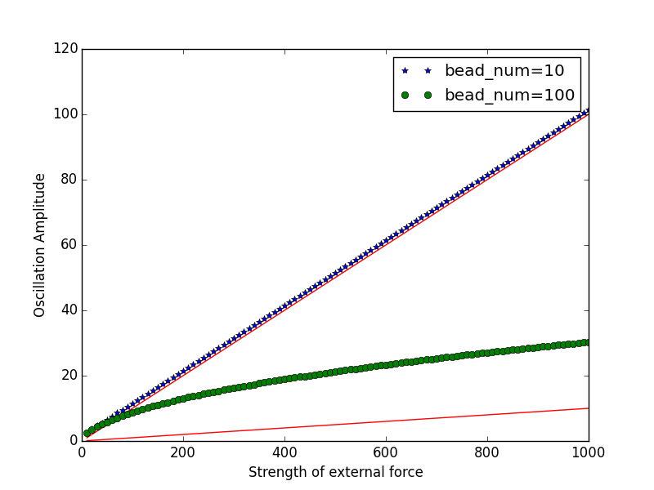
Driven Force & Oscillation Amplitude

